Slide 2

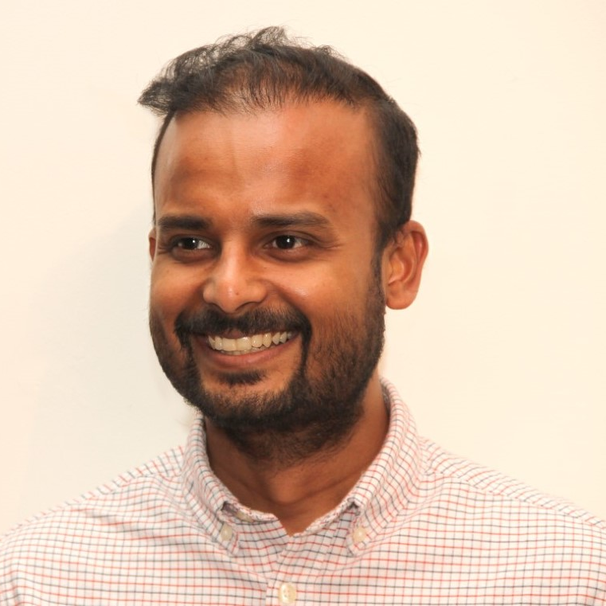


DUSHYANT PRIYADARSHEE
Senior Specialist, Platform Engineer NewDay, London
@rubberduckdev
https://www.rubberduckdev.com/
#AzConfDev
Notes:
A bit about me. I am Dushyant Priyadarshee and I work as a Platform Engineer at a company called NewDay London. I have roughly 10+ years of software development experience, mainly with Microsoft technologies, dotnet and recently heavily Azure based.

Slide 3
How to automate network security for your azure functions
Notes:
This conference is really jam packed with some exciting talks, from microservices, github actions, intelligent bots, xamarin and more. Hope all of you are enjoying the talks.
I am looking forward to the rest of the event. For now, we have an interesting topic to discuss, how to automate the network security for your azure functions. All the fun bits, automation, security and azure are included.

Slide 4

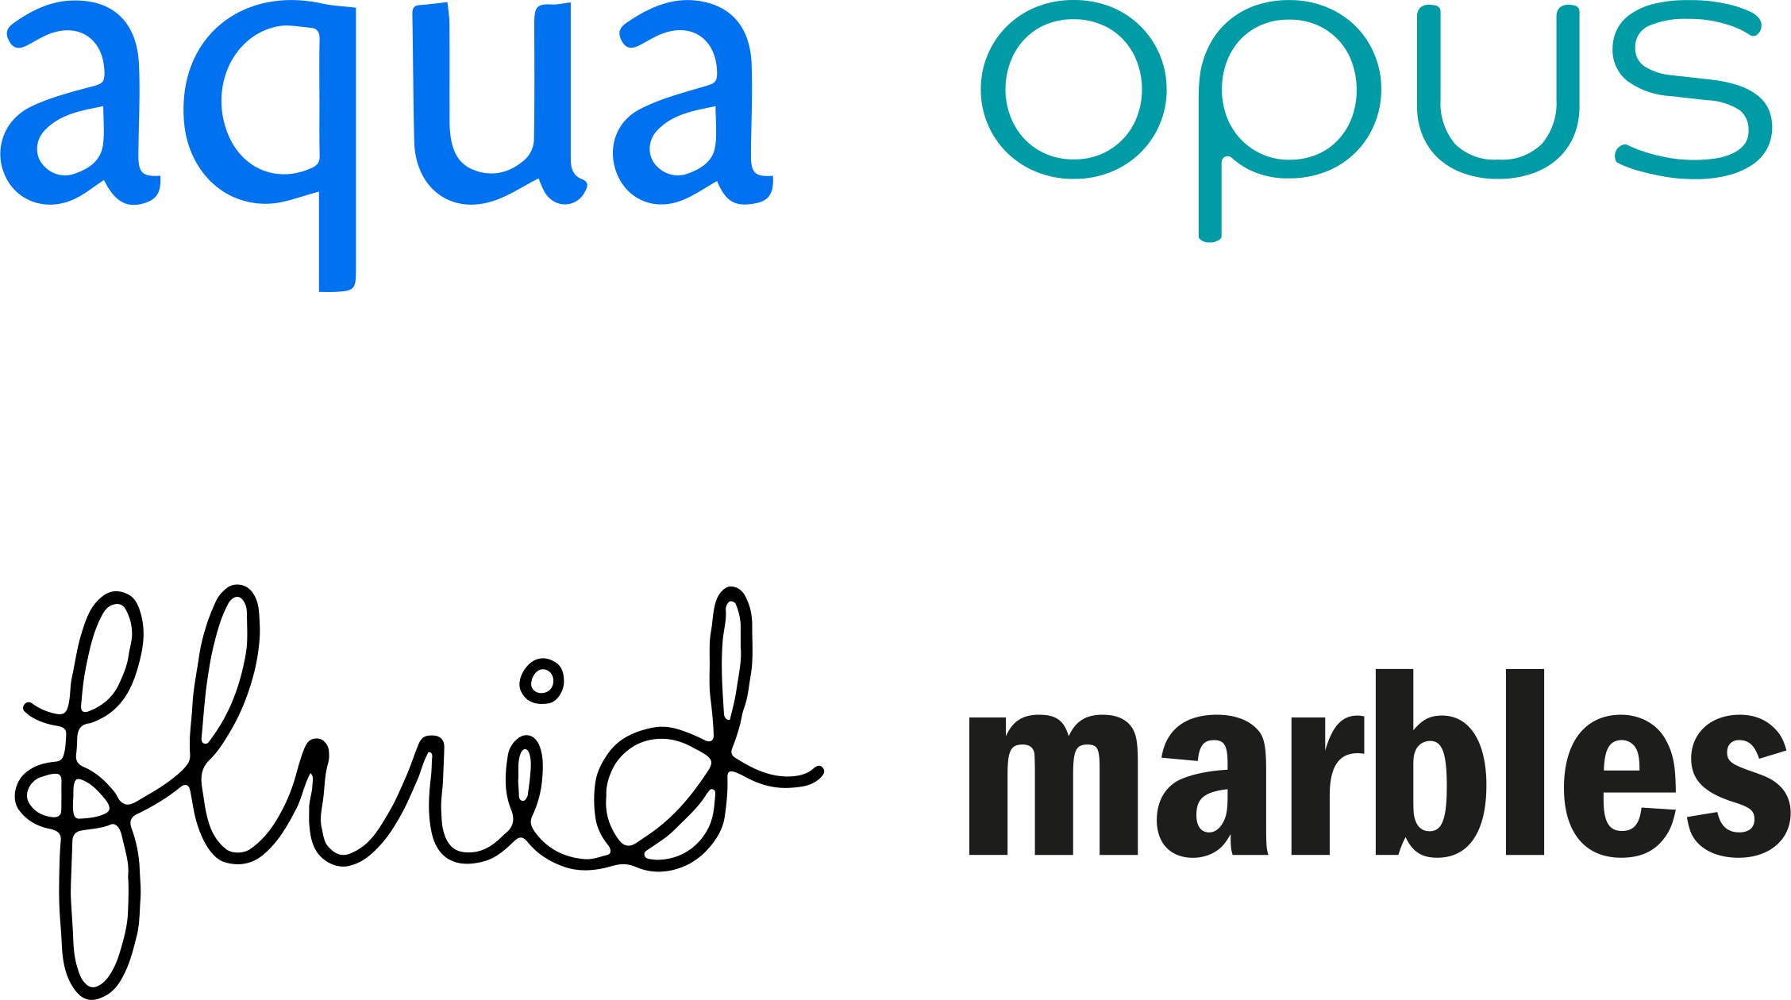
NewDay – Who we are
NewDay is one of the most inclusive lenders in the UK. With around five million customers, we cover a broad cross section of the UK credit market, responsibly saying yes to more customers than other lenders.
Retail Partnerships
Own-brands
MARCH 2020
1,300
Colleagues
£3bn+
Receivables
EACH YEAR
£6bn
Transactions processed
1.2m
New customers
NewDay provide fully branded credit, payment and loyalty solutions for some of the UK’s most established retailers
Near Prime, direct-to-consumer lending capability for purpose-built products
https://www.newday.co.uk/
Notes:
NewDay is a financial company dealing with credit cards. We have a host of reknowned retail partners as well as we provide our own credit cards. One of the aims of the company is to help people be better with credit and responsibly say yes to more customers.

Slide 5
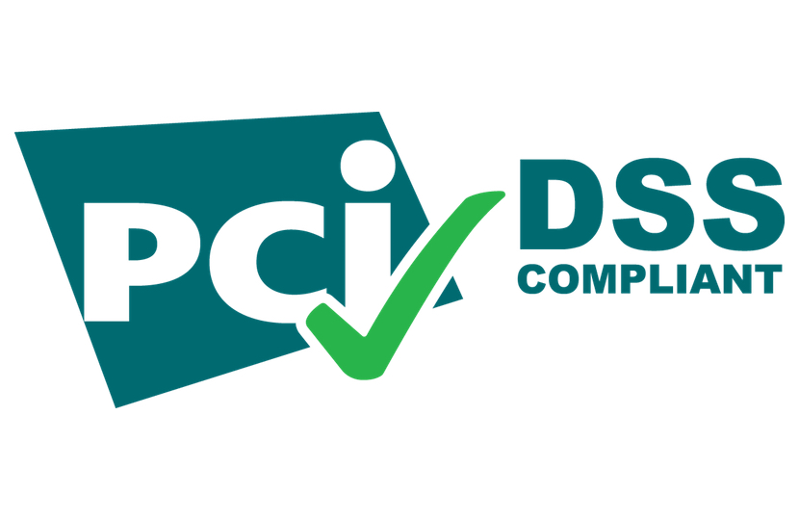























NewDay – Platform Tech
30+ Azure services
Notes:
The Payment Card Industry Data Security Standard is an information security standard for organizations that handle branded credit cards from the major card schemes. So we have serverless, microservices architecture on a public cloud and we are writing PCI DSS software, so I hope this emphasizes enough that security is very important in our business.
The Platform team I am part of, is responsible for the software platform, its resiliency, security among many other parameters and with help from multiple other teams we also are able to adopt some of the industry best practices in the field of CI CD and automation.

Slide 6
Accessing azure function
Who can trigger/access your Azure functions
Authentication/authorization
Azure front door, app gateway, API management, vnet integration
Network access restriction rules

Slide 7
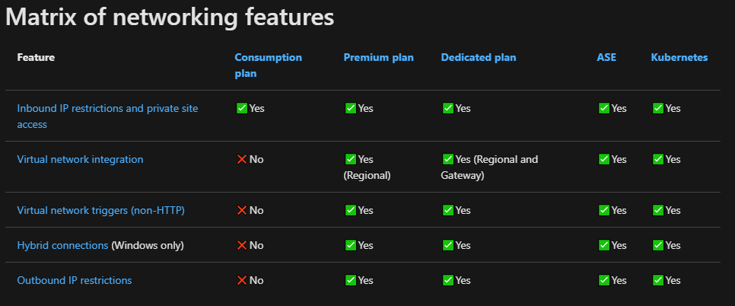
Access restriction rules
https://docs.microsoft.com/en-us/azure/azure-functions/functions-networking-options
Notes:
Explain why using restriction – least cost https://docs.microsoft.com/en-us/azure/azure-functions/functions-networking-options

Slide 8
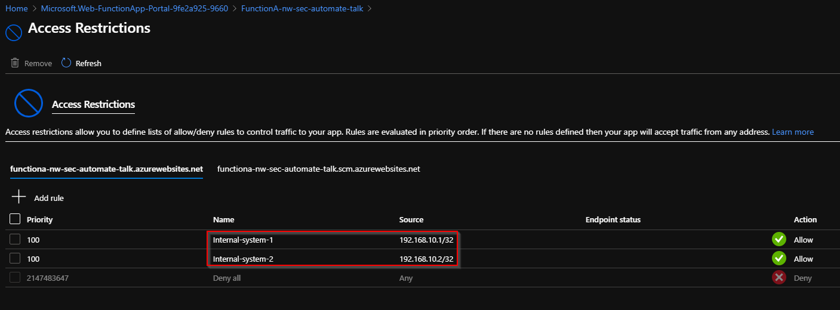
Demo - Network restrictions

Slide 9

The issue at hand – new function
(Internal-system-1) 192.168.10.1 (Internal-system-2) 192.168.10.2
Function B
Function A

Slide 10
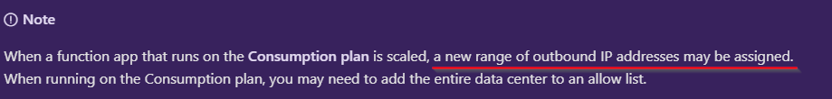
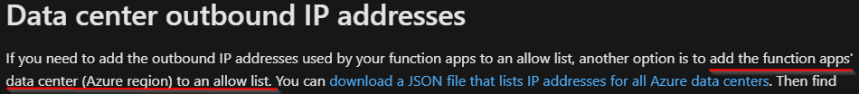
Add to it - scaling
https://docs.microsoft.com/en-us/azure/azure-functions/ip-addresses

Slide 11
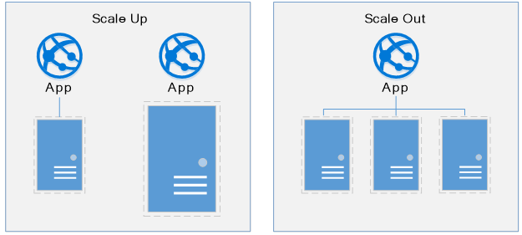
The issue at hand – scale up/out
(Internal-system-1) 192.168.10.1 (Internal-system-2) 192.168.10.2
Function B
Function A

Slide 12
The basic solution
(Internal-system-1) 192.168.10.1 (Internal-system-2) 192.168.10.2
Function C
Function A
Function B

Slide 13
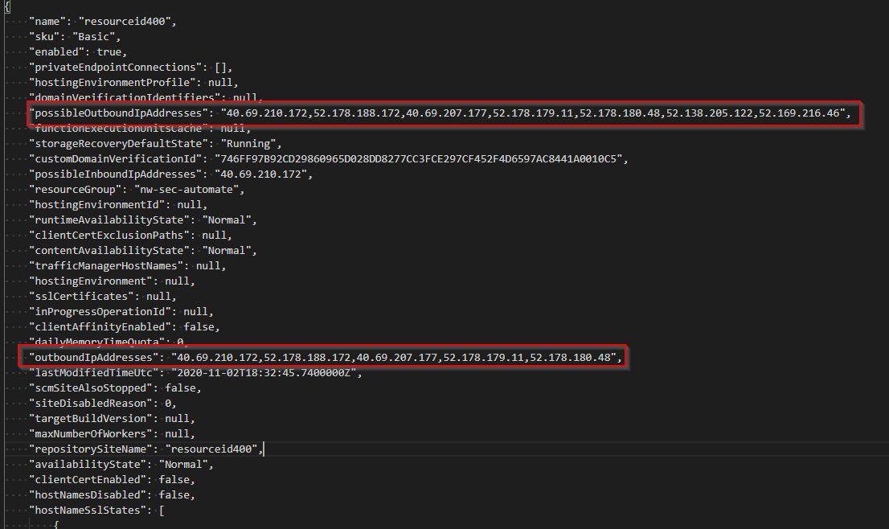
Outbound IP ranges
https://docs.microsoft.com/en-us/azure/azure-functions/ip-addresses#find-outbound-ip-addresses

Slide 14
So what do we need
Find out what to allow
Allow IPs
When to allow
Apply changes

Slide 15


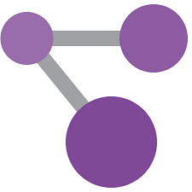
Selected technologies
Azure event grid
Azure resource graph
Azure function

Slide 16
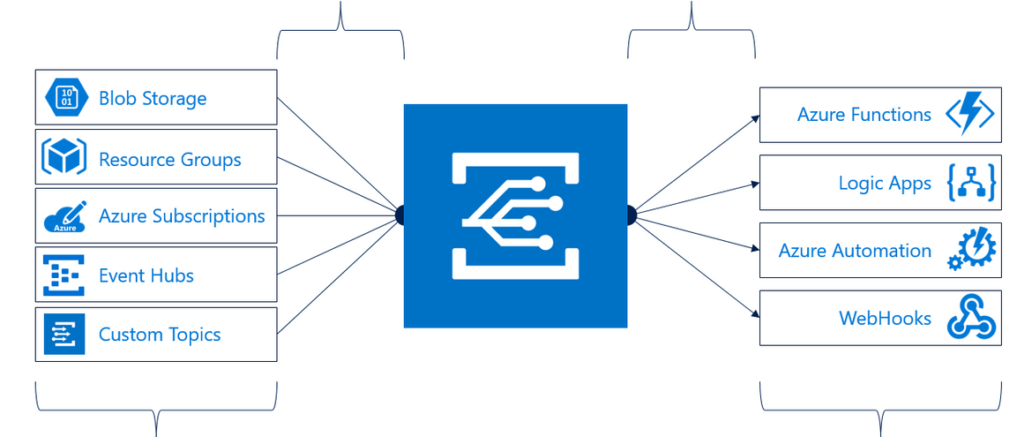
Azure event grid

Slide 17


Demo – Creating topic & subscription

Slide 18
Demo – Debugging event grid triggered function

Slide 19
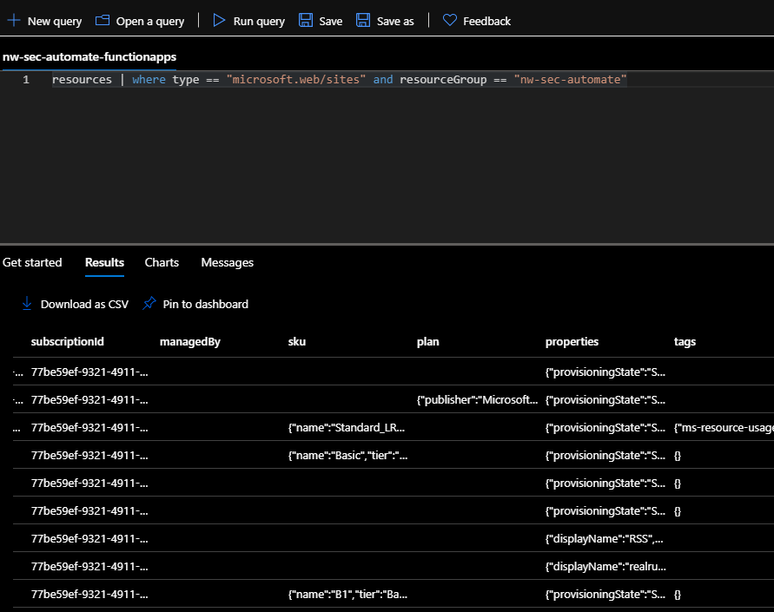
Demo - Azure resource graph

Slide 20

Selected technologies
Find out what to allow
Allow IPs
When to allow
Apply changes

Slide 21
Further complexities
App service
Virtual network
When a resource is deleted

Slide 22
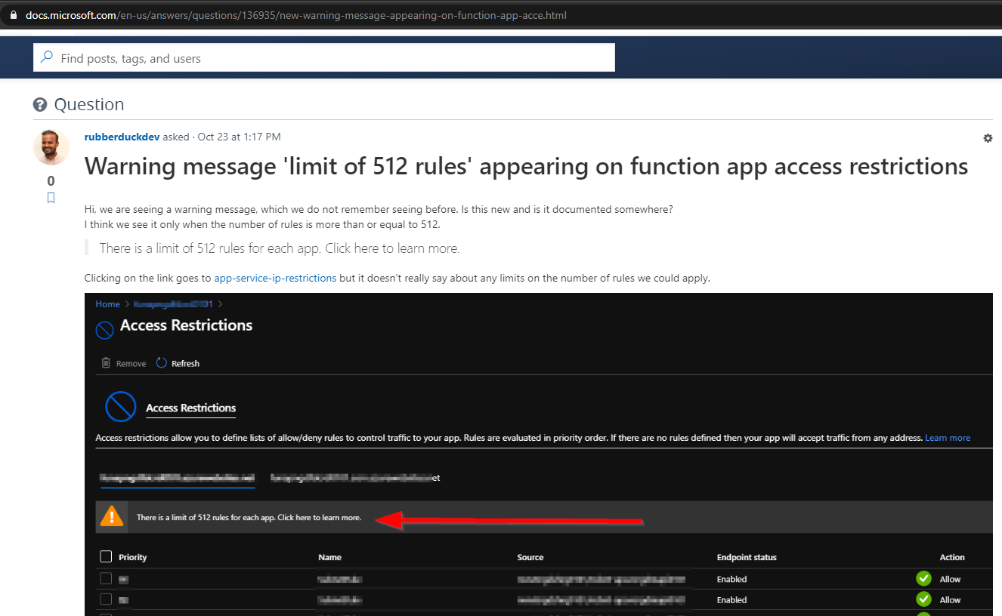
Further complexities
https://docs.microsoft.com/en-us/answers/questions/136935/new-warning-message-appearing-on-function-app-acce.html

Slide 23



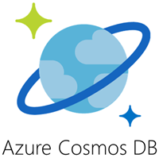
Update resources
ResourceScaledHandler(eventgrid event)
Get static rules
Generate rules then trigger
UpdateNetworkRestrictions(string resourceId, List rulesToAdd, List rulesToDelete)
ResourceDeletedHandler(eventgrid event)
CRUD – dependency graph to generate rules
{
"resourceId": "resource id of function-webapp",
"allowInbound": [
"resIdFun1",
"resIdFun2",
"AzureEventGrid"
],
"allowOutbound": [
"resIdFun3"
]
}
Generate rules then trigger
Keep dependency graph in database
UpdateNetworkRestrictions(JSON config)

Slide 24
Conclusion
Security is complex
Implementing principle of least privilege is even more complex
Cloud security is a shared responsibility
Demo scripts & code at:
https://github.com/realrubberduckdev/nw-sec-automate-talk

Slide 25
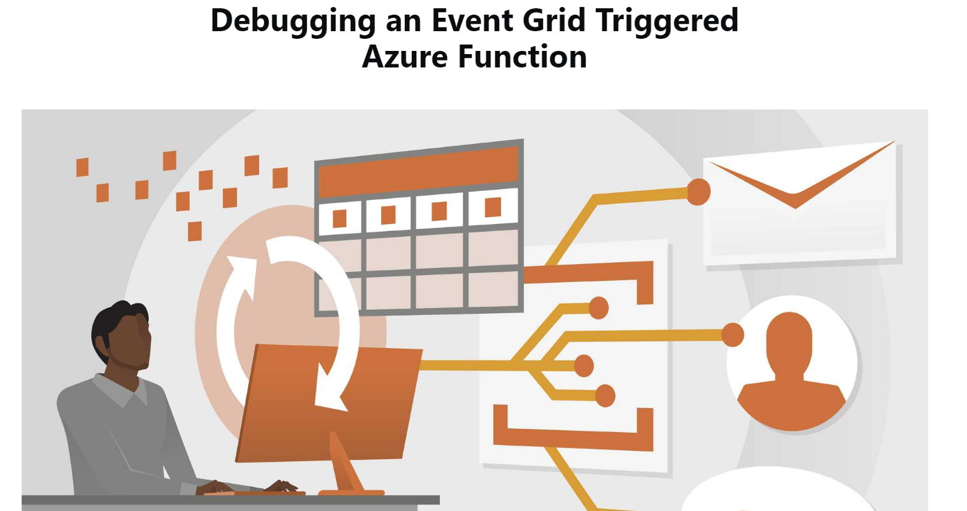
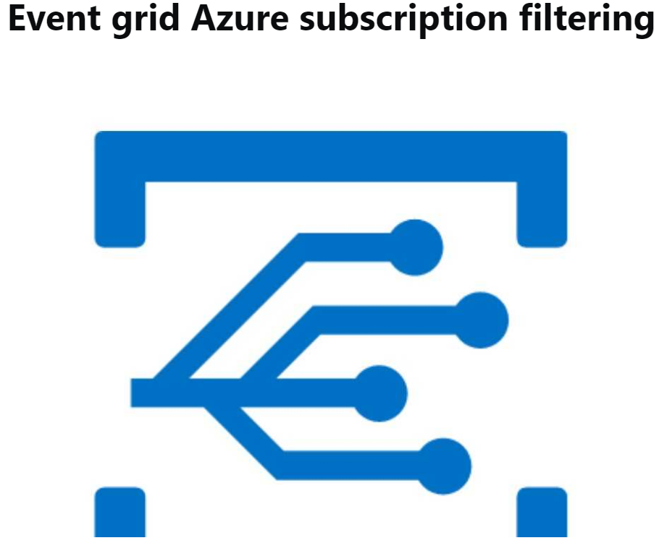
Extras – event grid
https://www.rubberduckdev.com/debugging-eg-function/
https://www.rubberduckdev.com/resource-provider-event-grid/
Cannot create diagnostic setting at Global location topic
Secured event delivery to functions with AAD
Create subscription for 'Azure subscription as an Event Grid source'

Slide 26
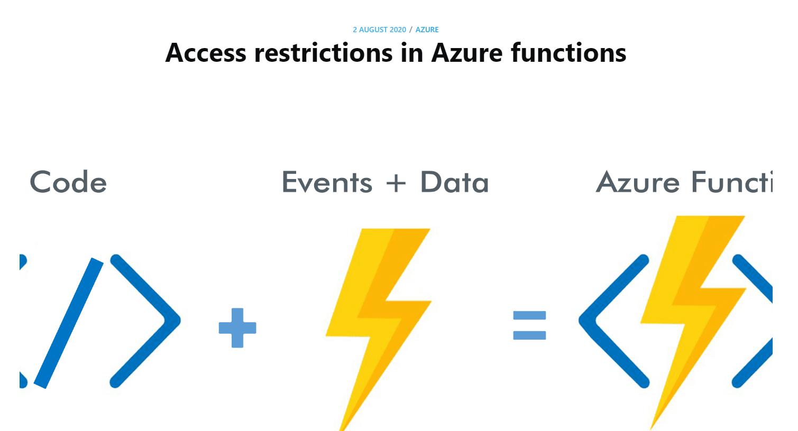
Extras – access restrictions & CIDR
https://www.rubberduckdev.com/funapp-testrun-nw-restriction/

Slide 27

Sponsors
DevOps Partner
#AzConfDev

Slide 28
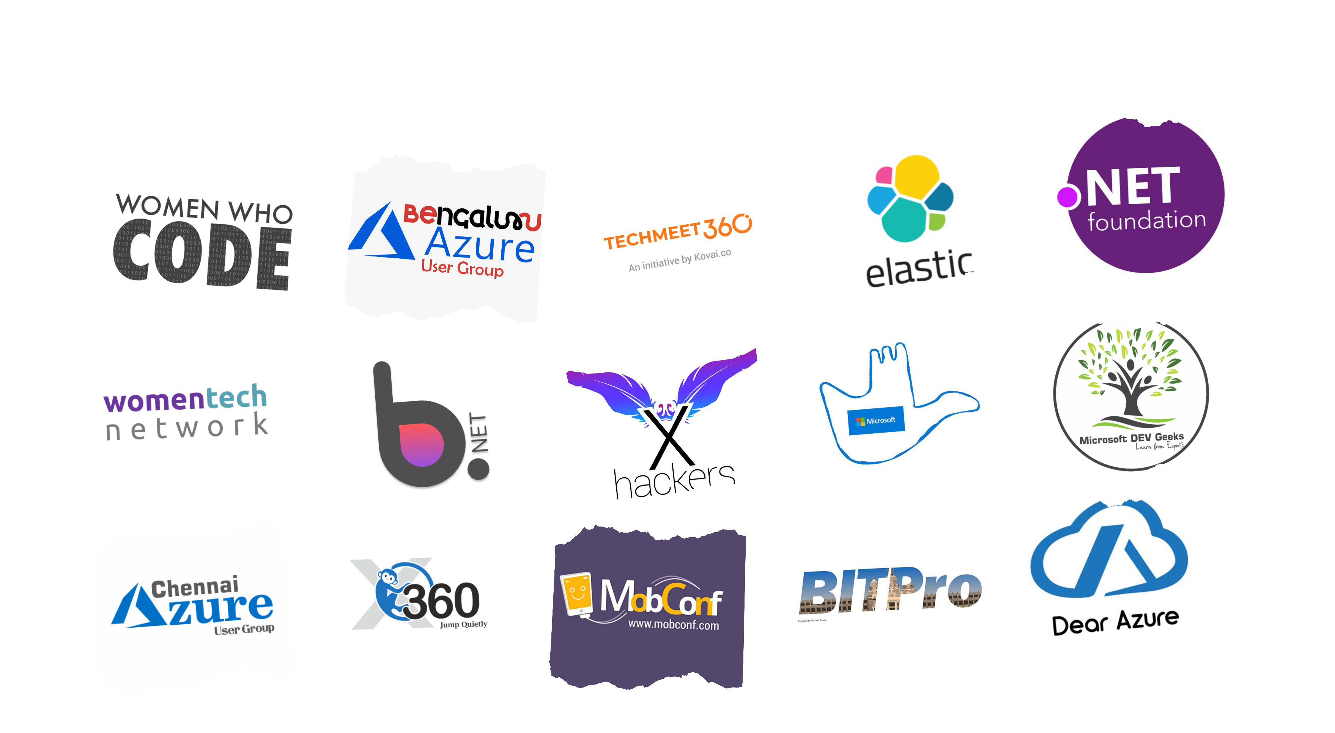
Communities
#AzConfDev

Slide 29
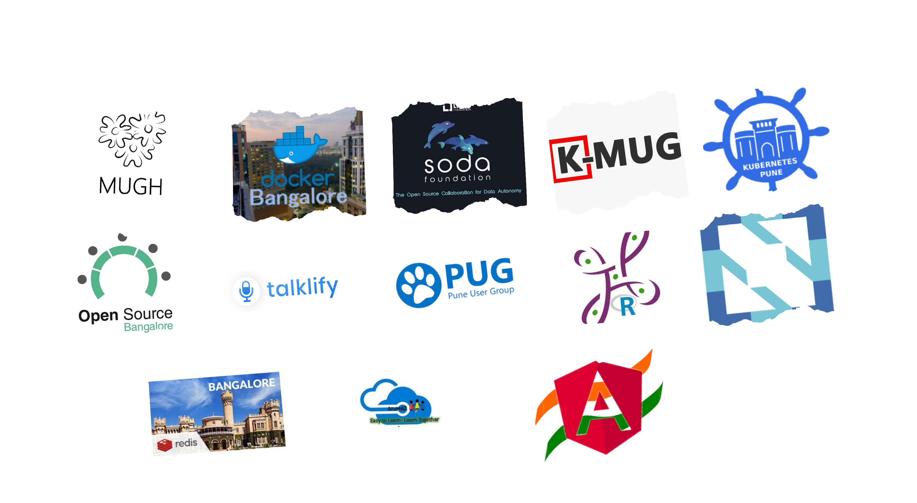
Communities
#AzConfDev

Slide 30


How to automate network security for your azure functions
Dushyant Priyadarshee
Thank You!
Senior Specialist, Platform Engineer NewDay, London
#AzConfDev

